Slide 1
Introduction to Exploratory Data Analysis

Slide 2
Outline
Introduction
What is EDA?
Descriptive Statistics
Central Tendency
Dispersion
Shape

Slide 3
What is Exploratory Data Analysis?
The analysis of datasets based on various numerical methods and graphical tools.
Exploring data for patterns, trends, underlying structure, deviations from the trend, anomalies and strange structures.
Techniques for visualizing and summarizing data.

Slide 4
Aims of Exploratory Data Analysis
Maximize insight into a dataset
Uncover underlying structure
Extract important variables
Detect outliers and anomalies
Test underlying assumptions
Develop valid models
Determine optimal factor settings (Xs)

Slide 5
Exploratory vs Confirmatory
Exploratory Data Analysis | Confirmatory Data Analysis
No hypothesis at first Generate hypothesis Uses graphical methods | Starts with hypothesis Test the null hypothesis Use statistical models

Slide 6
Outline
Introduction
What is EDA?
Descriptive Statistics
Central Tendency
Dispersion
Shape
Data Visualization

Slide 7
Descriptive Statistics
Refers to a branch of statistics that involves summarizing, organizing, and presenting data meaningfully and concisely.
It focuses on describing and analyzing a dataset's main features and characteristics without making any generalizations or inferences to a larger population.

Slide 8
Descriptive Statistics
The primary goal of descriptive statistics is to provide a clear and concise summary of the data, enabling researchers or analysts to gain insights and understand patterns, trends, and distributions within the dataset.

Slide 9
Descriptive Statistics
This summary typically includes measures such as:
Central tendency (e.g., mean, median, mode)
Dispersion (e.g., range, variance, standard deviation)
Shape of the distribution (e.g., skewness, kurtosis)

Slide 10
Central Tendency
In addition to describing the shape of the distribution of a sample or population of measurements, we also describe the data set’s central tendency.
A measure of central tendency represents the center or middle of the data. Sometimes we think of a measure of central tendency as a typical value.

Slide 11
Central Tendency
Measures of central tendency estimate a dataset's average or center.
Central tendency is defined as “the statistical measure that identifies a single value as representative of an entire distribution.”
It aims to provide an accurate description of the entire data.

Slide 12
Student | Age | Study Hours | Score | Gender
A | 18 | 12 | 85 | F
B | 19 | 5 | 60 | M
C | 17 | 9 | 78 | F
D | 18 | 15 | 90 | F
E | 20 | 7 | 65 | M
F | 21 | 3 | 50 | M
G | 19 | 11 | 82 | F
H | 18 | 2 | 45 | M
I | 22 | 4 | 55 | F
J | 20 | 14 | 88 | M

Slide 13
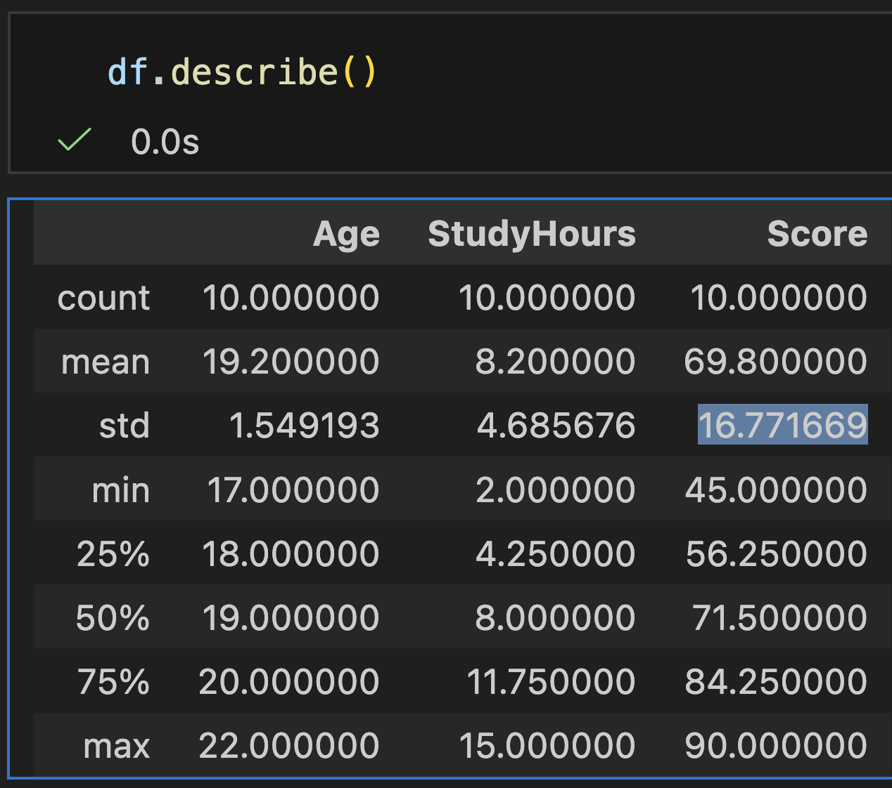
Student | Age | Study Hours | Score | Gender
A | 18 | 12 | 85 | F
B | 19 | 5 | 60 | M
C | 17 | 9 | 78 | F
D | 18 | 15 | 90 | F
E | 20 | 7 | 65 | M
F | 21 | 3 | 50 | M
G | 19 | 11 | 82 | F
H | 18 | 2 | 45 | M
I | 22 | 4 | 55 | F
J | 20 | 14 | 88 | M
In pandas, we can use .describe() to view the statistical summary of our dataset represented in a dataframe.

Slide 14
Central Tendency
Measure | Definition
Mean | The average of the sample measurements.
Median | Divides a population or sample into two roughly equal parts.
Mode | Measure the samples that appear most frequently

Slide 15
Student | Age | Study Hours | Score | Gender
A | 18 | 12 | 85 | F
B | 19 | 5 | 60 | M
C | 17 | 9 | 78 | F
D | 18 | 15 | 90 | F
E | 20 | 7 | 65 | M
F | 21 | 3 | 50 | M
G | 19 | 11 | 82 | F
H | 18 | 2 | 45 | M
I | 22 | 4 | 55 | F
J | 20 | 14 | 88 | M
We can see that student scores has an average of 69.8

Slide 16
Student | Age | Study Hours | Score | Gender
A | 18 | 12 | 85 | F
B | 19 | 5 | 60 | M
C | 17 | 9 | 78 | F
D | 18 | 15 | 90 | F
E | 20 | 7 | 65 | M
F | 21 | 3 | 50 | M
G | 19 | 11 | 82 | F
H | 18 | 2 | 45 | M
I | 22 | 4 | 55 | F
J | 20 | 14 | 88 | M
The mean of Age, Study Hours and Score are 19.2, 8.2 and 69.8 respectively.

Slide 17
Dispersion
Measure | Definition
Range | Calculate the difference between the highest and lowest scores
Variance | Calculate the average of the squared differences from the mean
Standard Deviation | Take the square root of the variance

Slide 18
Dispersion
Measure | Definition
Range | Calculate the difference between the highest and lowest scores
Variance | Calculate the average of the squared differences from the mean
Standard Deviation | Tells you how spread out the values are from the mean

Slide 19
Dispersion
Refers to the spread or variability of data points in a dataset.
It measures how much data values differ from each other and from a central point like the mean. Common measures of dispersion include the range, variance, standard deviation, and interquartile range.

Slide 20
Dispersion
Measure | Definition
Range | The difference between the highest and lowest scores
Variance | A measure of how far a set of numbers are spread out from their average value.
Standard Deviation | The square root of the Variance.
Interquartile Range | Tells us how tightly the middle half of the data is packed.

Slide 21
Student | Age | Study Hours | Score | Gender
A | 18 | 12 | 85 | F
B | 19 | 5 | 60 | M
C | 17 | 9 | 78 | F
D | 18 | 15 | 90 | F
E | 20 | 7 | 65 | M
F | 21 | 3 | 50 | M
G | 19 | 11 | 82 | F
H | 18 | 2 | 45 | M
I | 22 | 4 | 55 | F
J | 20 | 14 | 88 | M
Ages range 17 to 22

Slide 22
Student | Age | Study Hours | Score | Gender
A | 18 | 12 | 85 | F
B | 19 | 5 | 60 | M
C | 17 | 9 | 78 | F
D | 18 | 15 | 90 | F
E | 20 | 7 | 65 | M
F | 21 | 3 | 50 | M
G | 19 | 11 | 82 | F
H | 18 | 2 | 45 | M
I | 22 | 4 | 55 | F
J | 20 | 14 | 88 | M
Study hours range 2 to 15

Slide 23
Student | Age | Study Hours | Score | Gender
A | 18 | 12 | 85 | F
B | 19 | 5 | 60 | M
C | 17 | 9 | 78 | F
D | 18 | 15 | 90 | F
E | 20 | 7 | 65 | M
F | 21 | 3 | 50 | M
G | 19 | 11 | 82 | F
H | 18 | 2 | 45 | M
I | 22 | 4 | 55 | F
J | 20 | 14 | 88 | M
Scores range 45 to 90

Slide 24
Student | Age | Study Hours | Score | Gender
A | 18 | 12 | 85 | F
B | 19 | 5 | 60 | M
C | 17 | 9 | 78 | F
D | 18 | 15 | 90 | F
E | 20 | 7 | 65 | M
F | 21 | 3 | 50 | M
G | 19 | 11 | 82 | F
H | 18 | 2 | 45 | M
I | 22 | 4 | 55 | F
J | 20 | 14 | 88 | M
A percentile tells you the value below which a certain percentage of the data falls.

Slide 25
Student | Age | Study Hours | Score | Gender
A | 18 | 12 | 85 | F
B | 19 | 5 | 60 | M
C | 17 | 9 | 78 | F
D | 18 | 15 | 90 | F
E | 20 | 7 | 65 | M
F | 21 | 3 | 50 | M
G | 19 | 11 | 82 | F
H | 18 | 2 | 45 | M
I | 22 | 4 | 55 | F
J | 20 | 14 | 88 | M
Percentiles help you understand how data is spread out.

Slide 26
Student | Age | Study Hours | Score | Gender
A | 18 | 12 | 85 | F
B | 19 | 5 | 60 | M
C | 17 | 9 | 78 | F
D | 18 | 15 | 90 | F
E | 20 | 7 | 65 | M
F | 21 | 3 | 50 | M
G | 19 | 11 | 82 | F
H | 18 | 2 | 45 | M
I | 22 | 4 | 55 | F
J | 20 | 14 | 88 | M
The 25th percentile means 25% of the values are below this number.

Slide 27
Student | Age | Study Hours | Score | Gender
A | 18 | 12 | 85 | F
B | 19 | 5 | 60 | M
C | 17 | 9 | 78 | F
D | 18 | 15 | 90 | F
E | 20 | 7 | 65 | M
F | 21 | 3 | 50 | M
G | 19 | 11 | 82 | F
H | 18 | 2 | 45 | M
I | 22 | 4 | 55 | F
J | 20 | 14 | 88 | M
The 50th percentile (median) means half of the data is below this number.

Slide 28
Student | Age | Study Hours | Score | Gender
A | 18 | 12 | 85 | F
B | 19 | 5 | 60 | M
C | 17 | 9 | 78 | F
D | 18 | 15 | 90 | F
E | 20 | 7 | 65 | M
F | 21 | 3 | 50 | M
G | 19 | 11 | 82 | F
H | 18 | 2 | 45 | M
I | 22 | 4 | 55 | F
J | 20 | 14 | 88 | M
The 75th percentile means 75% of the values are below this number.

Slide 29
Student | Age | Study Hours | Score | Gender
A | 18 | 12 | 85 | F
B | 19 | 5 | 60 | M
C | 17 | 9 | 78 | F
D | 18 | 15 | 90 | F
E | 20 | 7 | 65 | M
F | 21 | 3 | 50 | M
G | 19 | 11 | 82 | F
H | 18 | 2 | 45 | M
I | 22 | 4 | 55 | F
J | 20 | 14 | 88 | M
If we choose Score and look closely at its percentiles

Slide 30
Student | Age | Study Hours | Score | Gender
A | 18 | 12 | 85 | F
B | 19 | 5 | 60 | M
C | 17 | 9 | 78 | F
D | 18 | 15 | 90 | F
E | 20 | 7 | 65 | M
F | 21 | 3 | 50 | M
G | 19 | 11 | 82 | F
H | 18 | 2 | 45 | M
I | 22 | 4 | 55 | F
J | 20 | 14 | 88 | M
We can see that the 25th percentile is 56.25

Slide 31
45, 50, 55, 60, 65, 78, 82, 85, 88, 90
If we sorted the scores from lowest to highest, 56.25 is between the 2nd and 3rd value

Slide 32
45, 50, 55, 60, 65, 78, 82, 85, 88, 90
Which means that 25 percent of the values in Score is below this number.

Slide 33
45, 50, 55, 60, 65, 78, 82, 85, 88, 90
Next, we can see that the 50th percentile for Score is 71.5

Slide 34
45, 50, 55, 60, 65, 78, 82, 85, 88, 90
This means that 50 percent of the data in Score is below 71.5

Slide 35
45, 50, 55, 60, 65, 78, 82, 85, 88, 90
Finally, the 75th percentile is 84.2 which means that 75% of the values in Score is below 84.2

Slide 36
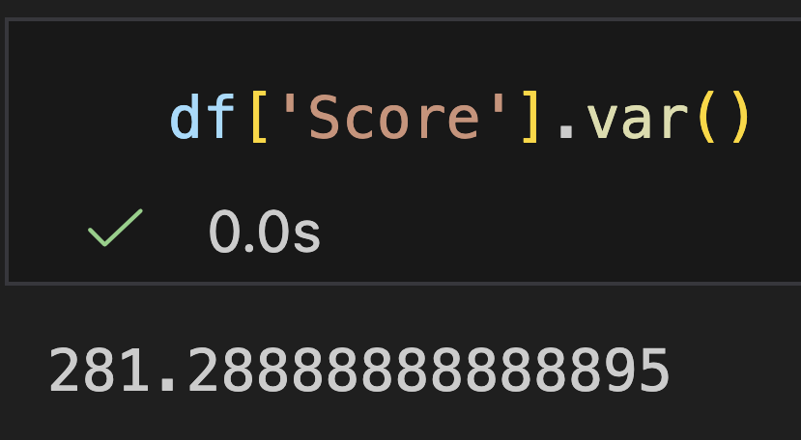
Student | Age | Study Hours | Score | Gender
A | 18 | 12 | 85 | F
B | 19 | 5 | 60 | M
C | 17 | 9 | 78 | F
D | 18 | 15 | 90 | F
E | 20 | 7 | 65 | M
F | 21 | 3 | 50 | M
G | 19 | 11 | 82 | F
H | 18 | 2 | 45 | M
I | 22 | 4 | 55 | F
J | 20 | 14 | 88 | M
Variance does not appear in .describe() but we can use .var() to see the variance for a certain column

Slide 37
Shape of the Distribution
When reviewing a dataset, it is important if the samples are normally distributed.
Knowing whether a sample is normally distributed is important because many statistical methods, tests, and models assume normality. If the data is not normal, the results of those methods may be invalid, misleading, or less powerful.

Slide 38
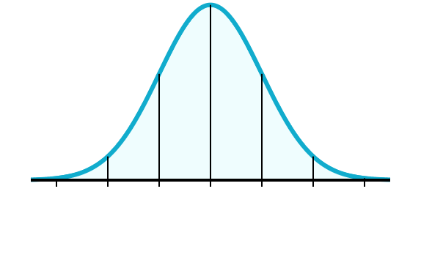
Shape of the Distribution
A normal distribution has a bell-shaped density curve described by its mean and standard deviation .
The density curve is symmetrical, centered about its mean, with its spread determined by its standard deviation.

Slide 39
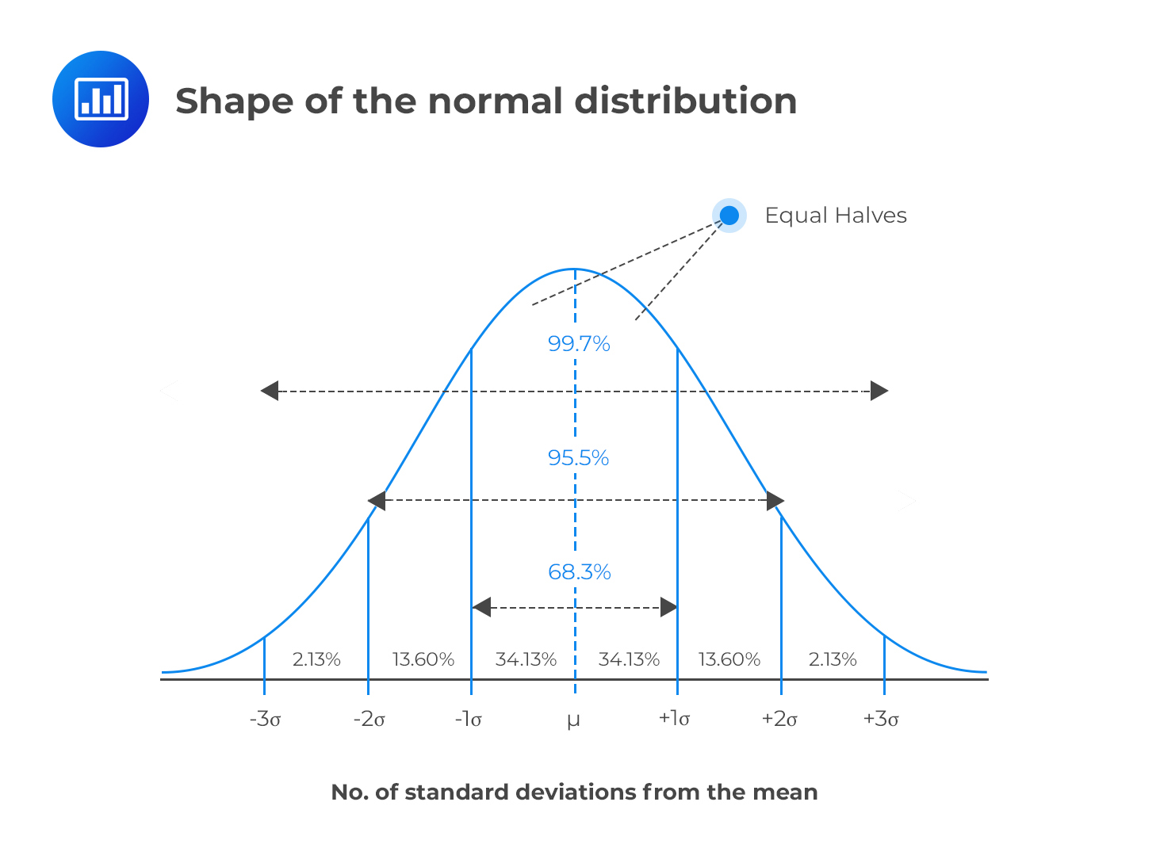

Slide 40
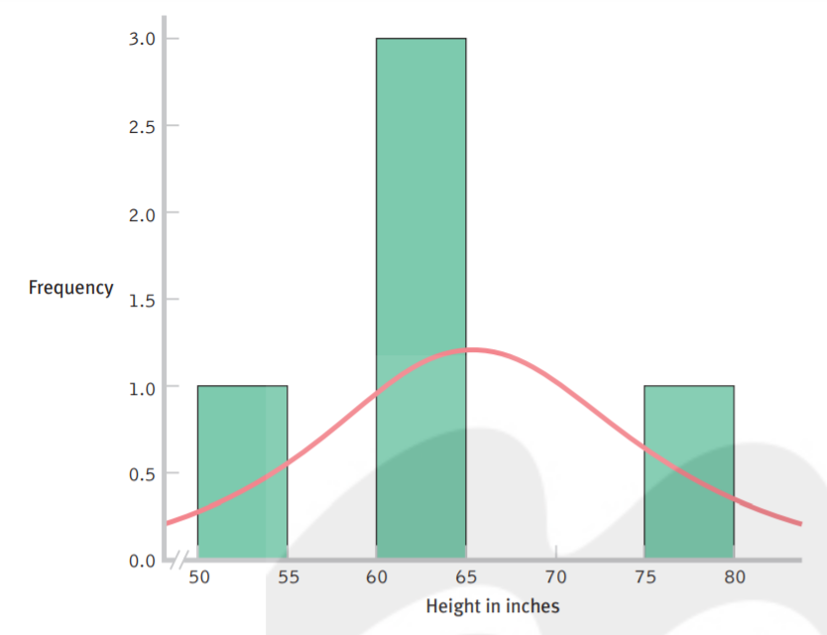
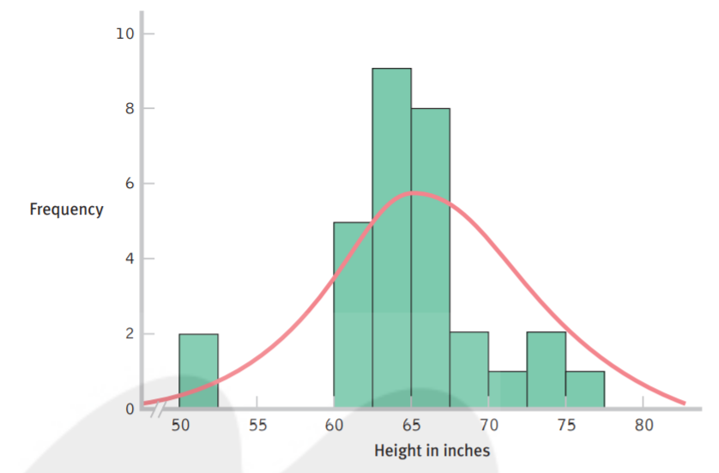
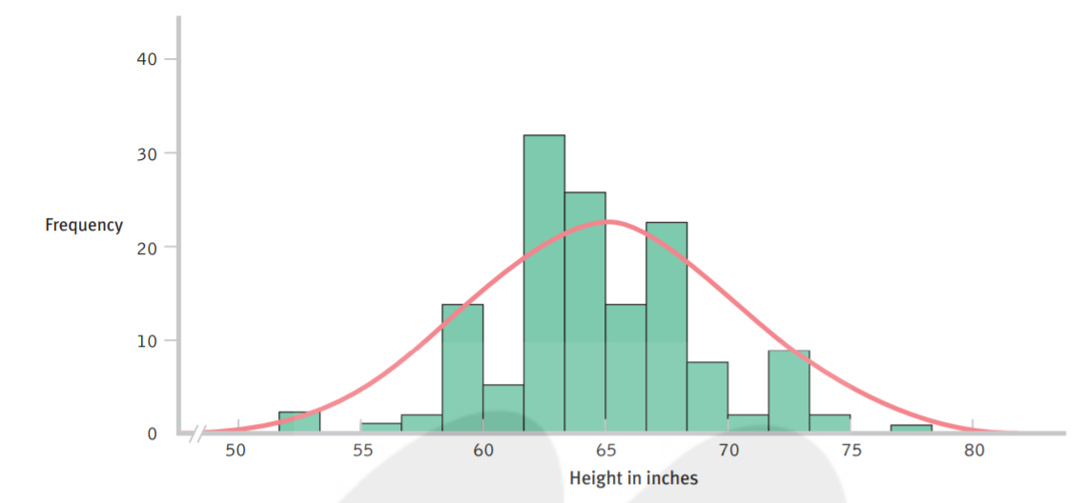
Here is a histogram of the heights, in inches, of 30 students. With a larger sample, the data begin to resemble the normal curve of an entire population of heights.
Here is a histogram of the heights, in inches, of 5 students. With so few students, the data are unlikely to closely resemble the normal curve that we would see for an entire population of heights.
The general rule of n ≥ 30 applies
Here is a histogram of the heights, in inches, of 140 students. As the sample size increases, the shape of the distribution becomes more and more like the normal curve we would see for an entire population
Joseph Marvin R. Imperial

Slide 41
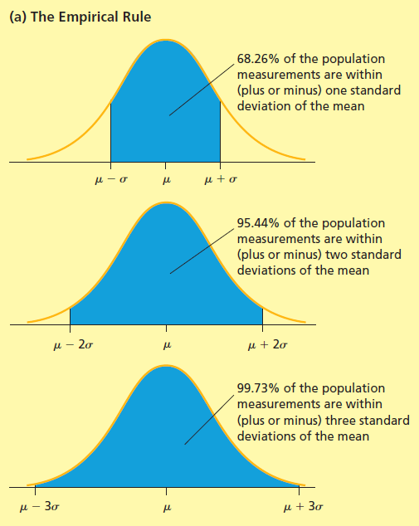
Empirical Rule
One type of relative frequency curve describing a population is the normal curve.
The normal curve is a symmetrical, bell-shaped curve and is illustrated on the right.
If a population is described by a normal curve, we say that the population is normally distributed.

Slide 42
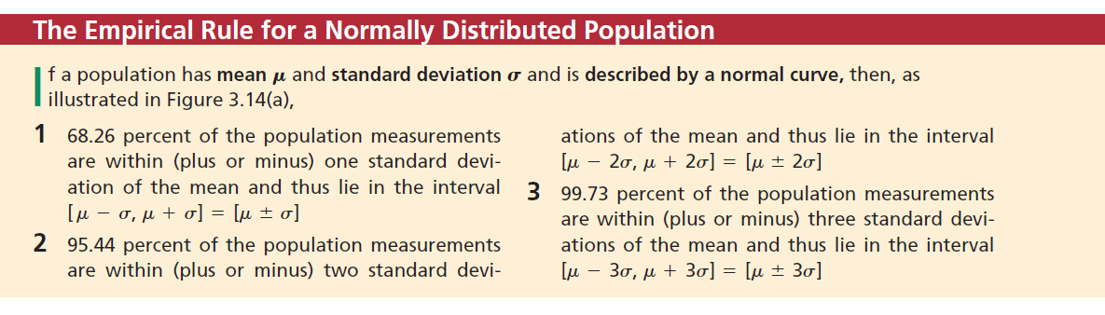
Empirical Rule

Slide 43
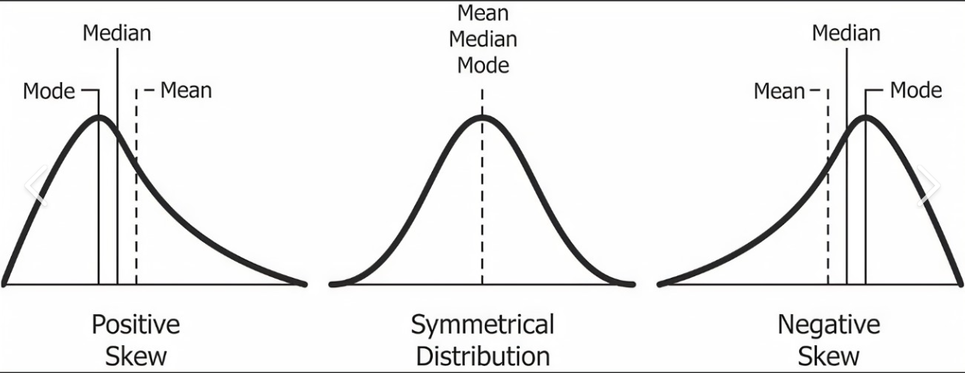
Skewness
There are methods for quantifying the lack of symmetry or skewness

Slide 44
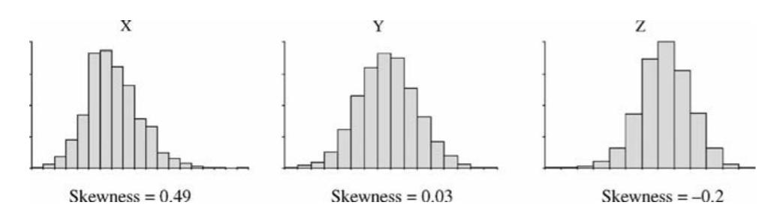
Skewness
A skewness value of nearer zero indicates that the distribution is symmetrical.
A skewness value of positive indicates that the right tail is longer than the left tail.
A skewness value of negative indicates that the left tail is longer than the right tail.

Slide 45
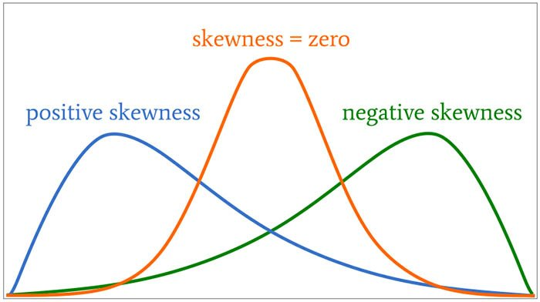
Skewness
A skewness value of nearer zero indicates that the distribution is symmetrical.
A skewness value of positive indicates that the right tail is longer than the left tail.
A skewness value of negative indicates that the left tail is longer than the right tail.

Slide 46
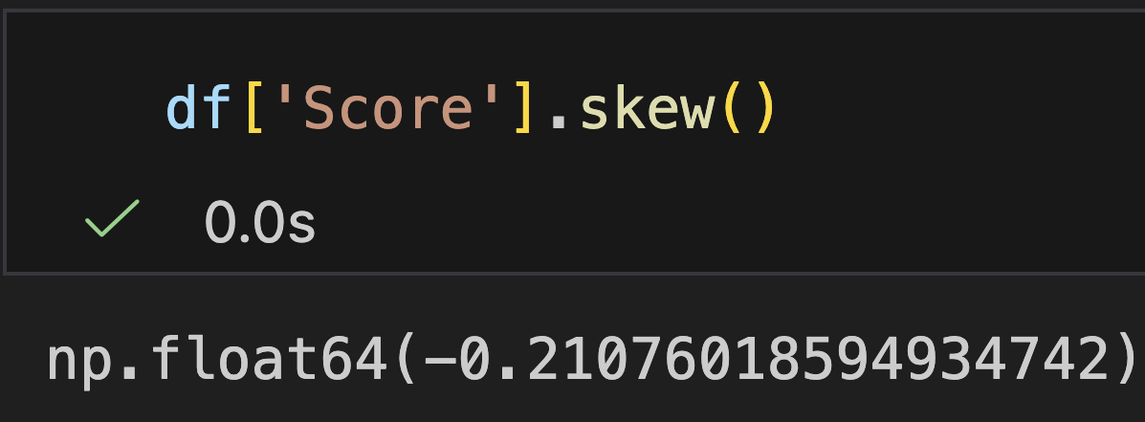
Student | Age | Study Hours | Score | Gender
A | 18 | 12 | 85 | F
B | 19 | 5 | 60 | M
C | 17 | 9 | 78 | F
D | 18 | 15 | 90 | F
E | 20 | 7 | 65 | M
F | 21 | 3 | 50 | M
G | 19 | 11 | 82 | F
H | 18 | 2 | 45 | M
I | 22 | 4 | 55 | F
J | 20 | 14 | 88 | M
In pandas, we can use .skew(). We can see that for Score, it is left skewed

Slide 47
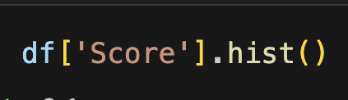
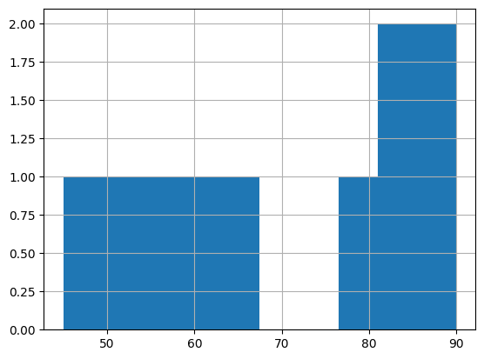
Student | Age | Study Hours | Score | Gender
A | 18 | 12 | 85 | F
B | 19 | 5 | 60 | M
C | 17 | 9 | 78 | F
D | 18 | 15 | 90 | F
E | 20 | 7 | 65 | M
F | 21 | 3 | 50 | M
G | 19 | 11 | 82 | F
H | 18 | 2 | 45 | M
I | 22 | 4 | 55 | F
J | 20 | 14 | 88 | M
We can use .hist() to visualize it.

Slide 48
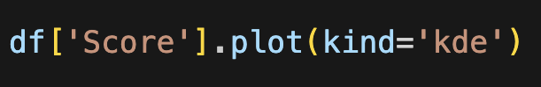
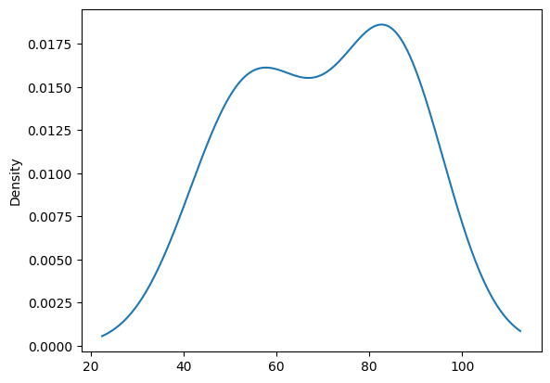
Student | Age | Study Hours | Score | Gender
A | 18 | 12 | 85 | F
B | 19 | 5 | 60 | M
C | 17 | 9 | 78 | F
D | 18 | 15 | 90 | F
E | 20 | 7 | 65 | M
F | 21 | 3 | 50 | M
G | 19 | 11 | 82 | F
H | 18 | 2 | 45 | M
I | 22 | 4 | 55 | F
J | 20 | 14 | 88 | M
Or use a Kernel Density Estimate plot using .plot(kind=‘kde’)

Slide 49
Kurtosis
The measurement of how heavily the tails of a distribution differ from the tails of a normal distribution is also important. This measurement is defined as kurtosis.
Kurtosis identifies whether the tails of a given distribution contain extreme values or outliers. The kurtosis of a normal distribution equals / approx. = 1.

Slide 50
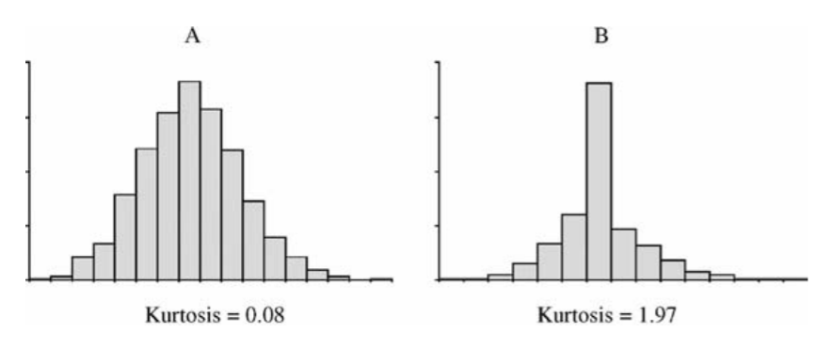
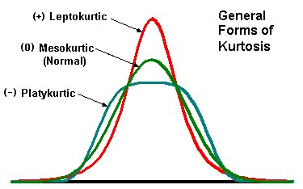
Kurtosis identifies whether the tails of a given distribution contain extreme values or outliers. The kurtosis of a normal distribution equals / approx. = 1.

Slide 51
The measurement of how heavily the tails of a distribution differ from the tails of a normal distribution is also important. This measurement is defined as kurtosis.

Slide 52
Variables with a pronounced peak (leptokurtic) toward the mean have a high kurtosis score (+ excess kurtosis) and variables with a flat peak (platykurtic) have a low kurtosis score (- excess kurtosis).

Slide 53
A leptokurtic distribution may be prone to extreme values on either side / outliers while a platykurtic distribution often has flat tails indicating small outliers in a distribution

Slide 54
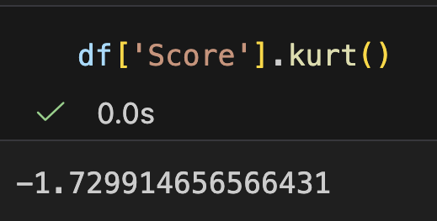
Student | Age | Study Hours | Score | Gender
A | 18 | 12 | 85 | F
B | 19 | 5 | 60 | M
C | 17 | 9 | 78 | F
D | 18 | 15 | 90 | F
E | 20 | 7 | 65 | M
F | 21 | 3 | 50 | M
G | 19 | 11 | 82 | F
H | 18 | 2 | 45 | M
I | 22 | 4 | 55 | F
J | 20 | 14 | 88 | M
We can use .kurt()to find the kurtosis.

Slide 55
Example: 20 student data
Suppose you have the following scores of 20 students on an exam:
85, 90, 75, 92, 88, 79, 83, 95, 87, 91, 78, 86, 89, 94, 82, 80, 84, 93, 88, 81
MEAN | 86
MEDIAN | 86.5
MODE | 88
RANGE | 20
VARIANCE | 33.25
STANDARD DEVIATION | 5.77

Slide 56
References

